Slide 1


VISUAL GUIDE
2023

Slide 2

Index
ETHICHUB VISUAL GUIDE 2022
Who We Are
The Font
Our Colors
The Logo
Web Elements
Art Direction
Glossary

Slide 3
Who We Are

Slide 4
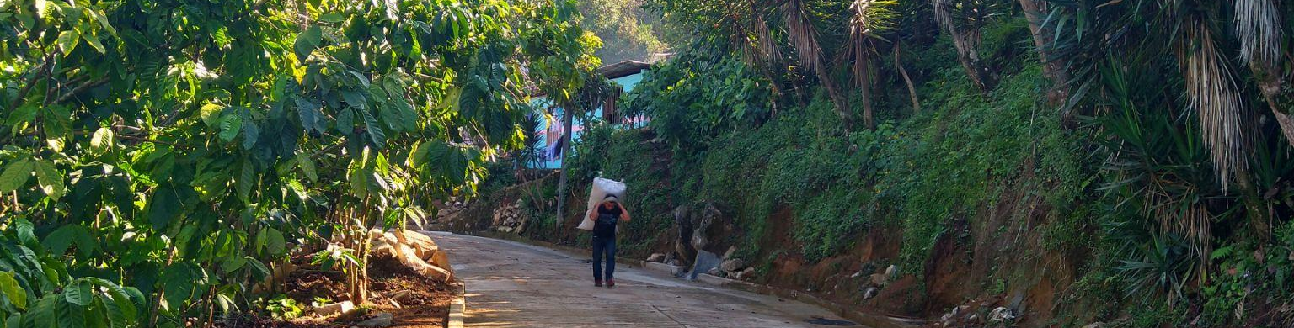
ETHICHUB VISUAL GUIDE 2022
Connecting Yield Farmers to actual Farmers
Did you know that a quarter of the people in the world are excluded from the financial system? This horrible dysfunction makes them pay over 100% interest for the little money they can borrow from local sharks. Most of the excluded are small farmers producing our food and living in poverty despite working so hard.It’s hard to work all year round to get all your income once a year, because you need to borrow to feed your family, to tend your land. That’s the reality of over 1 billion farmers trapped in the poverty cycle. They are good payers but there is no record or data to prove it. Enormous inequalities keep growing from such lack of trust.
Connecting People, Harvesting Wealth!
EthicHub uses blockchain to finance these farmers. We leverage on the global paradox of millions paying absurd interest when others have even negative rates for our savings in the bank! We build an international community to generate social, economic and environmental impact.

Slide 5
The Font

Slide 6
Typography
ETHICHUB VISUAL GUIDE 2022
Friendly and rounded as the peer to peer technology. Clear numbers for transparent transactions.
N U N I T O
A B C D E F G H I J K L M N O P Q R S T U V W X Y Z
a b c d e f g h i j k l m n o p q r s t u v w x y z
1 2 3 4 5 6 7 8 9 0 > < ! ” · $ % & / ( ) = ? ¿ ^ * Ç ¨ _ : ;
A B C D E F G H I J K L M N O P Q R S T U V W X Y Z
a b c d e f g h i j k l m n o p q r s t u v w x y z
1 2 3 4 5 6 7 8 9 0 > < ! ” · $ % & / ( ) = ? ¿ ^ * Ç ¨ _ : ;
R E G U L A R
B O L D
Nunito
Nunito Sans
Download font
Download font

Slide 7
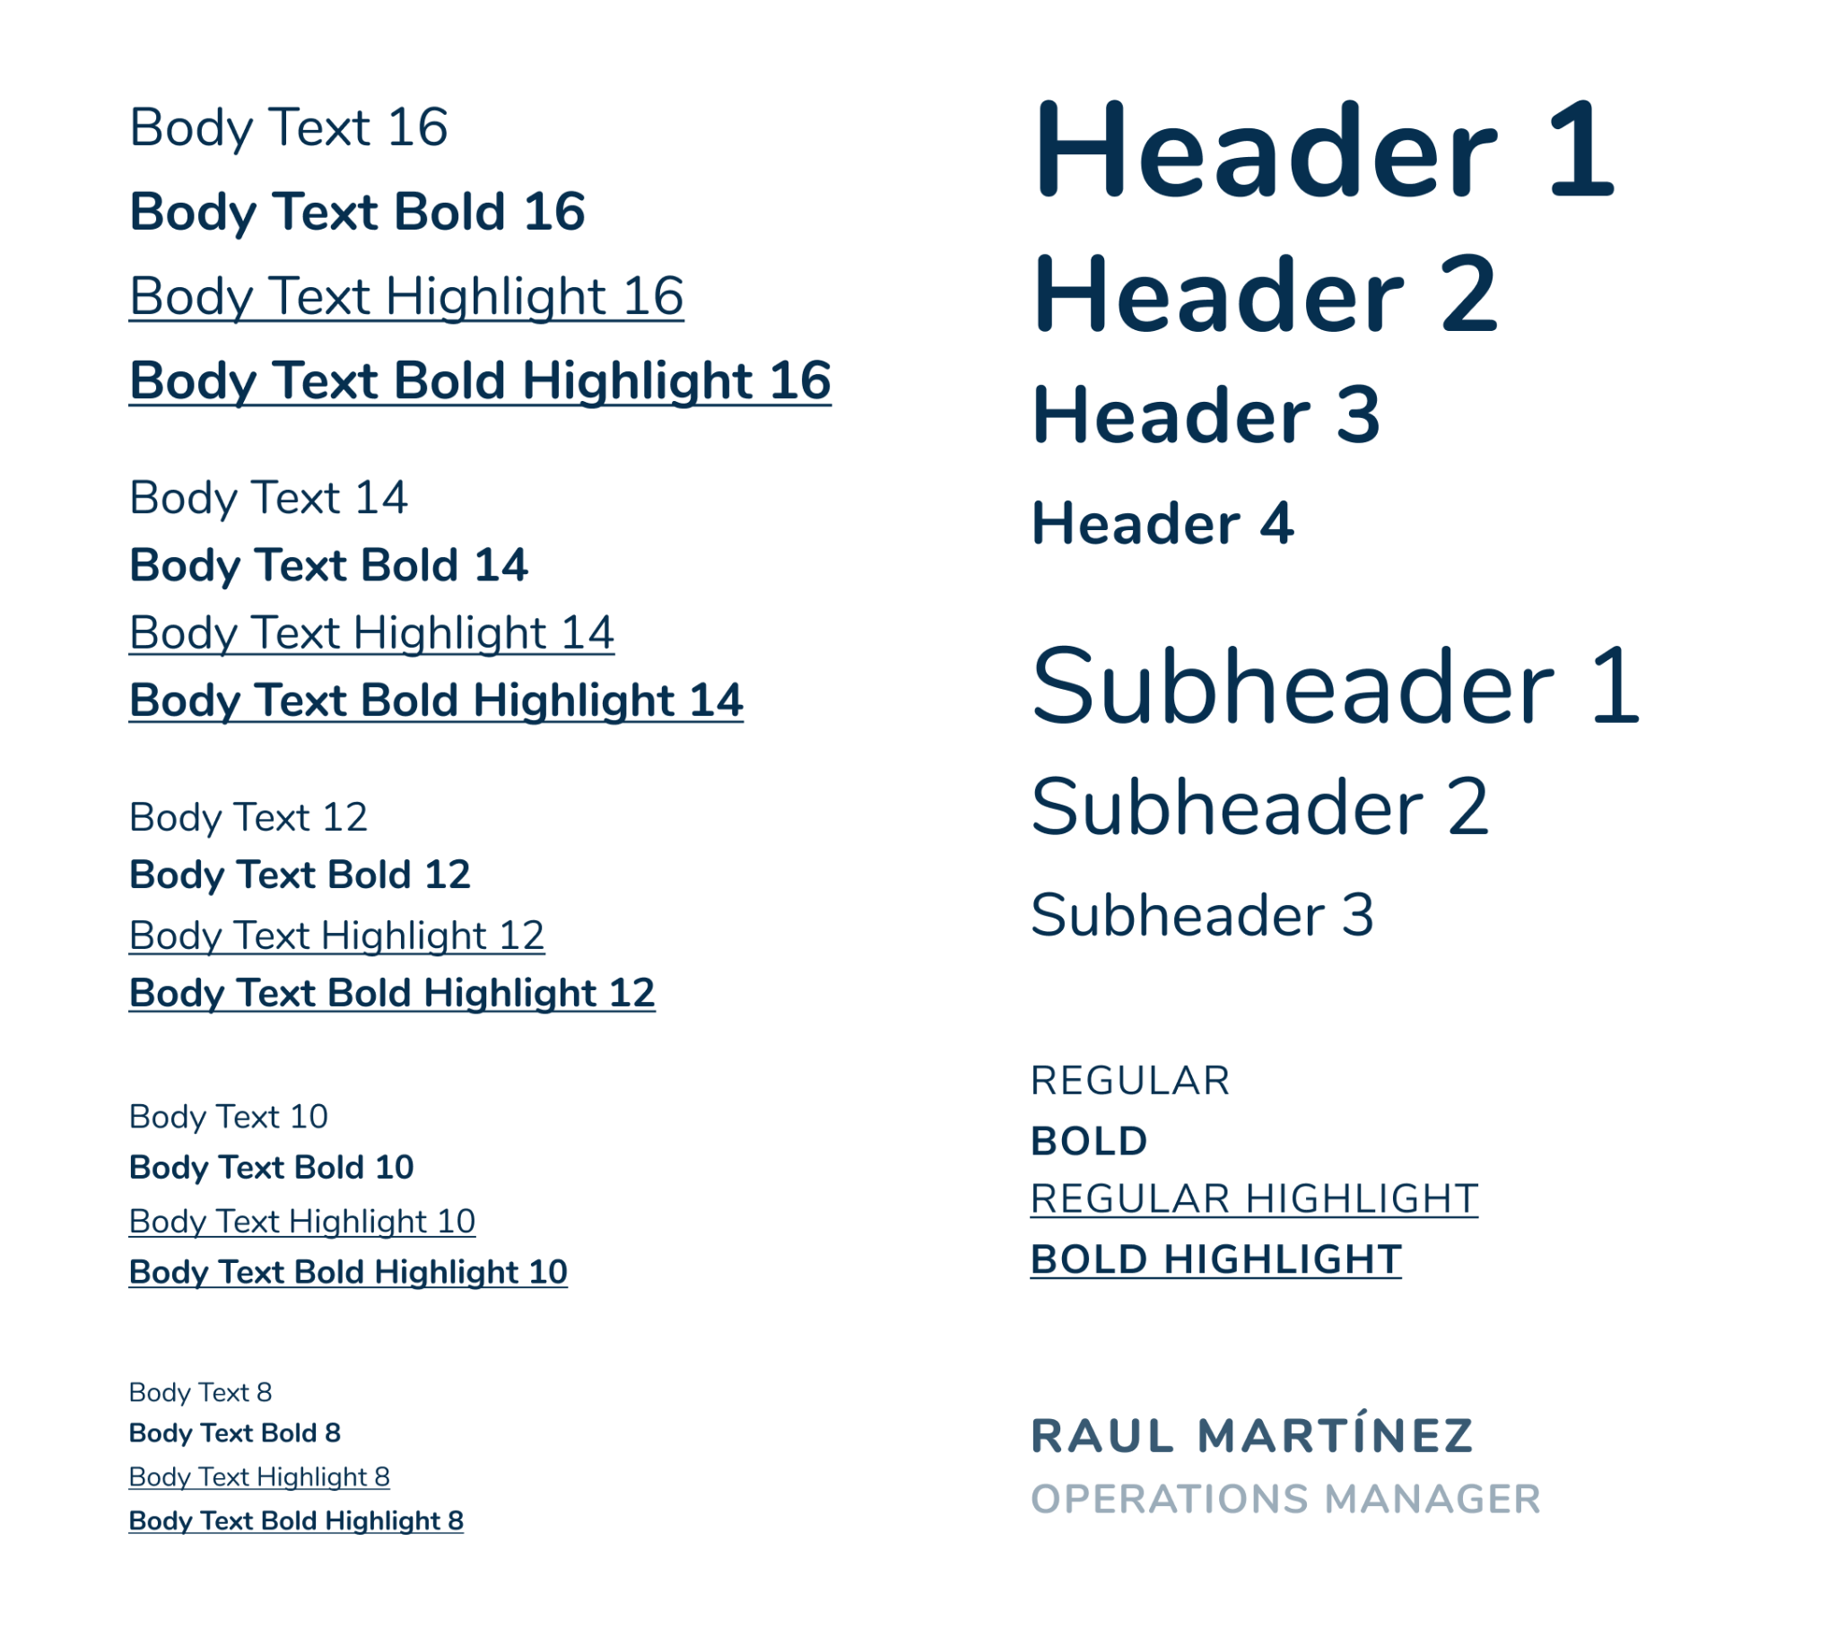
Font Sizes
ETHICHUB VISUAL GUIDE 2022
Nunito and Nunito Sans. As friendly and rounded as the peer to peer technology. Clear numbers for transparent transactions.
TITLES
BODY TEXT
SPECIAL TEXT

Slide 8
Our Colors

Slide 9

Colors
ETHICHUB VISUAL GUIDE 2022
Green and blue as the agriculture, bright as the technology, serious, too, as the economy is.
#87F96E
#062F4F
PRIMARY
RGB
CMYK
PANTONE
135,249,110
60, 0,100,0
7487 C
RGB
CMYK
PANTONE
6,47,79
92, 41, 0, 69
289 C
DARK
#F9FAF8
#74D7DC
#E6EAE5
RGB
249,250,248
RGB
CMYK
116,215,220
50, 0, 20, 0
RGB
CMYK
230,234,229
2, 0, 2, 8
LIGHTER
SECONDARY
LIGHT

Slide 10
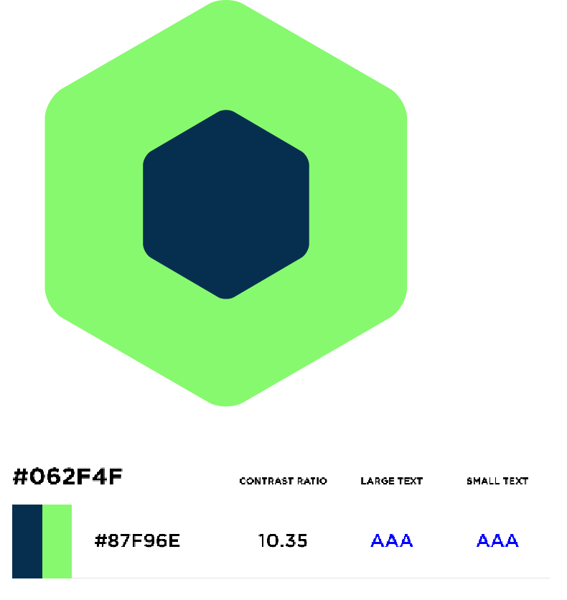
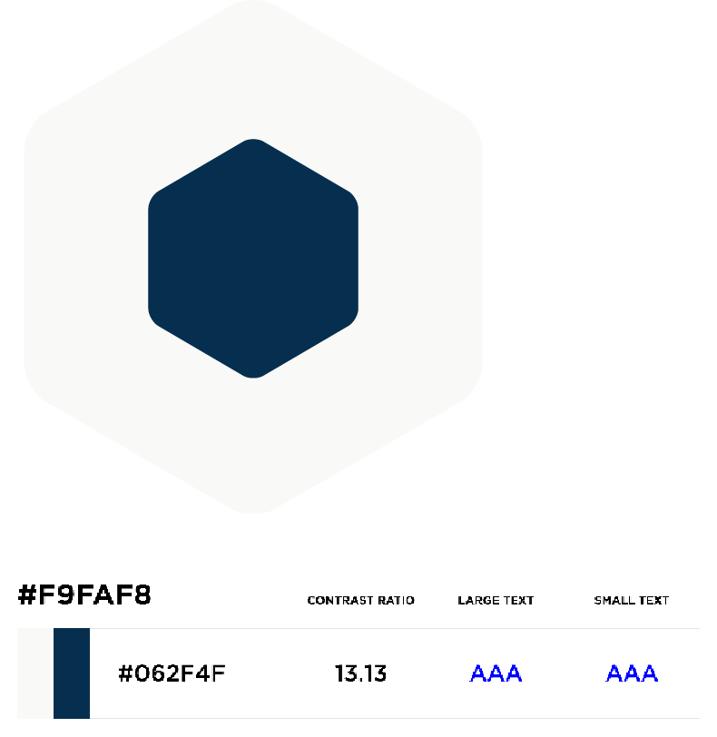
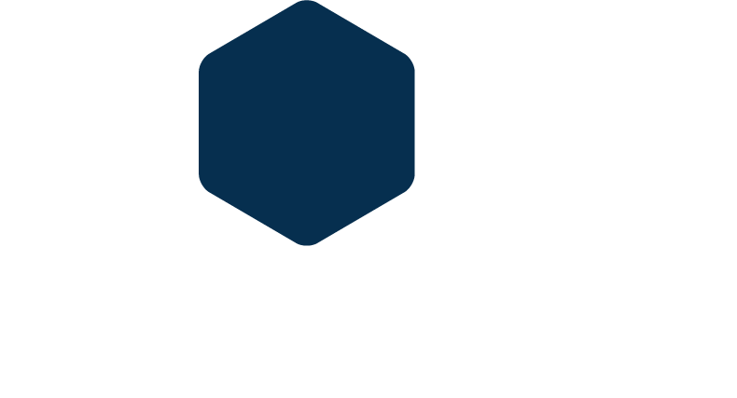
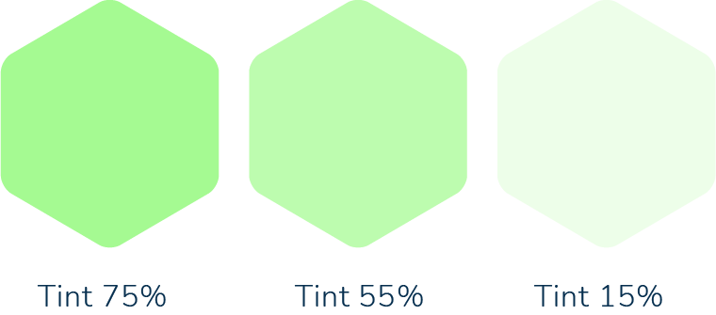
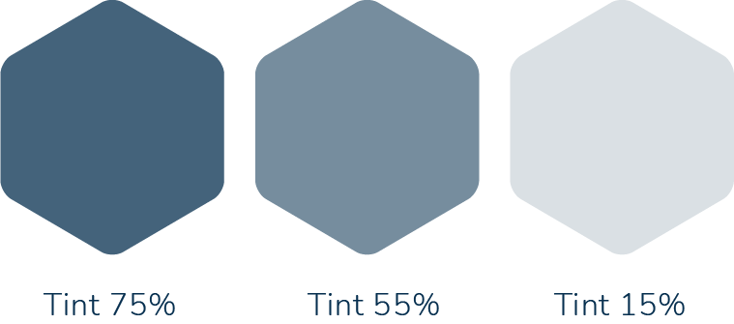
Using Colors II
ETHICHUB VISUAL GUIDE 2022
We like to be serious when the situation deserves it
DARK OVER PRIMARY
DARK OVER WHITE
DARK OVER LIGHTER GRAY
Dark blue is the main color for text and CTAs. Primary green works for preserve EthicHub´s identity in the background, so readability in print and digital channels are guaranteed.
Dark blue over white works for print or digital materials which allows only one color.
Lighter Gray works mainly as background for digital media..
The use of different shades of Primary Green is permitted
The use of different shades of Primary Green is permitted

Slide 11
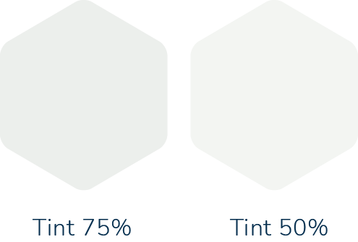
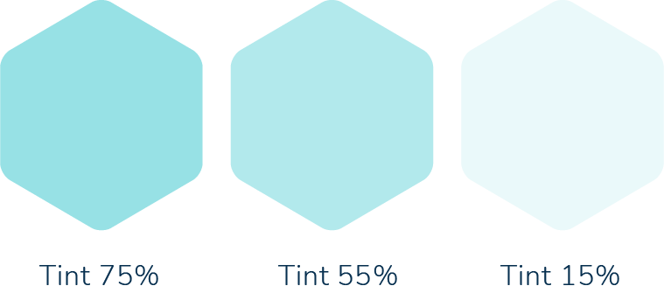
Using Colors II
ETHICHUB VISUAL GUIDE 2022
LIGHTER GRAY
LIGHT GRAY
SECONDARY AQUA
Digital
- Backgrounds
Print
- NOT ALLOWED
Digital
- Diagrams and shapes
Print
- Backgrounds, diagrams, shapes
Digital
- Backgrouds, diagrams and shapes
Print
- Backgrouds, diagrams and shapes
The use of different shades of Primary Green is permitted
The use of different shades of Primary Green is permitted

Slide 12
The Logo

Slide 13
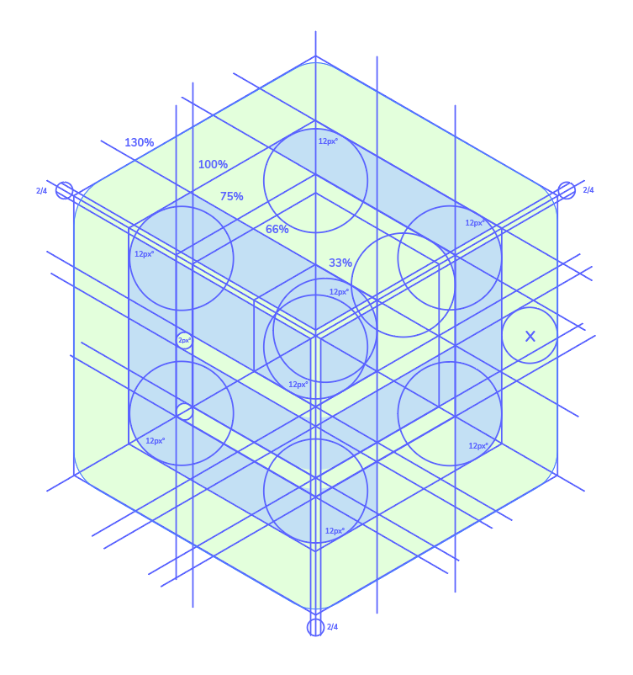
Symbol Construction
ETHICHUB VISUAL GUIDE 2022

Slide 14
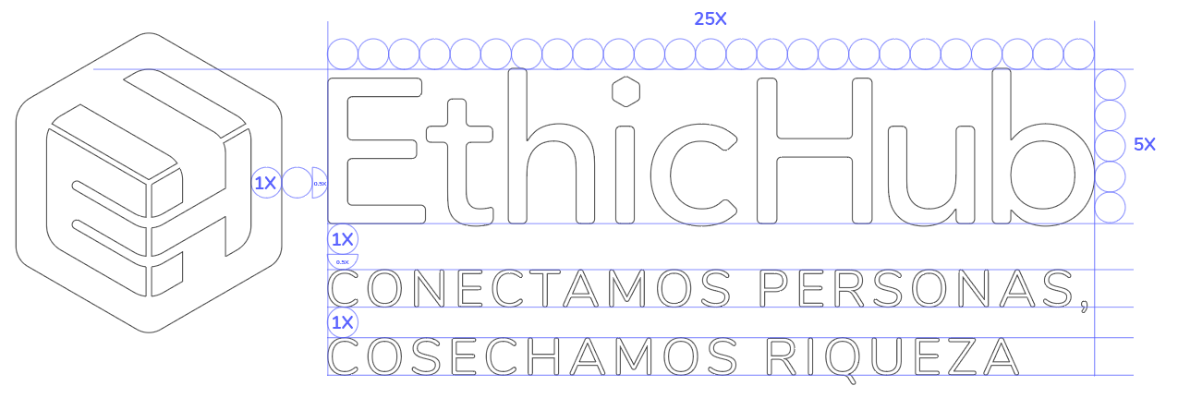
Logo Construction
ETHICHUB VISUAL GUIDE 2022
Our EthicBlocks are creating bridges for a better economy.
MAIN VERSION
REDUCED VERSION

Slide 15

Minimum Reserved Space
ETHICHUB VISUAL GUIDE 2022
We recommend keeping some space around, your lend will improve people spaces, too.
Download logo + claim (EN)
Download logo + claim (ESP)

Slide 16



Gray Scale / Black&White Versions
ETHICHUB VISUAL GUIDE 2022
We recommend keeping some space around, your lend will improve people spaces, too.
OVER WHITE
DARK BACKGROUNDS
10% BLACK
50% BLACK
50% BLACK
ALL THE ELEMENTS ARE WHITE

Slide 17



Alternate version (Vertical)
ETHICHUB VISUAL GUIDE 2022
Depending on the case, a secondary version may be used to fit a vertical or small design space.
COLOR
GRAY SCALE
DARK BACKGROUND
Download CMYK logo
Download RGB logo

Slide 18


Other Platforms
ETHICHUB VISUAL GUIDE 2022
On the Ethix app or others platforms, the use of the Token’s name or logos are needed to clarify.
Download logo RGB
Download logo CMYK

Slide 19





Other Platforms
ETHICHUB VISUAL GUIDE 2022
Cryptocafé is the point where technology and farmer’s production meet. A place where Ethichubers can meet and learn about crypto world. GO TO VISUAL GUIDE
COLOR
SYMBOL
CHARACTER
VERTICAL
COLOR
GRAY SCALE
DARK BACKGROUNDS
HORIZONTAL
Horizontal Logo
Vertical Logo

Slide 20
Web Elements

Slide 21








Buttons / Call To Action
ETHICHUB VISUAL GUIDE 2022
The hierarchy in color is used to show the importance of certain actions on the EthicHub website.
COMMON
WITH ICON
PRIMARY
SECONDARY
TERTIARY
INACTIVE
For prioritary actions like buying.
For redirectioning between pages.
For user-optional actions.
For actions on hold and waiting for user/system input.

Slide 22







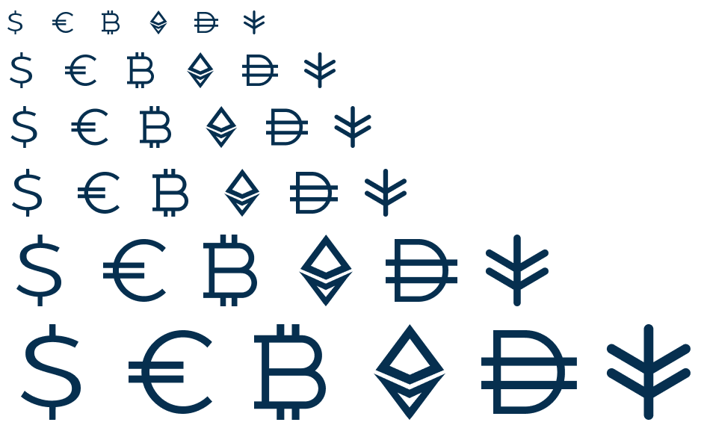







Icons & Symbols
ETHICHUB VISUAL GUIDE 2022
Icons and symbols should be prioritary outlined to avoid heavy visual weight.

Slide 23
Art Direction

Slide 24
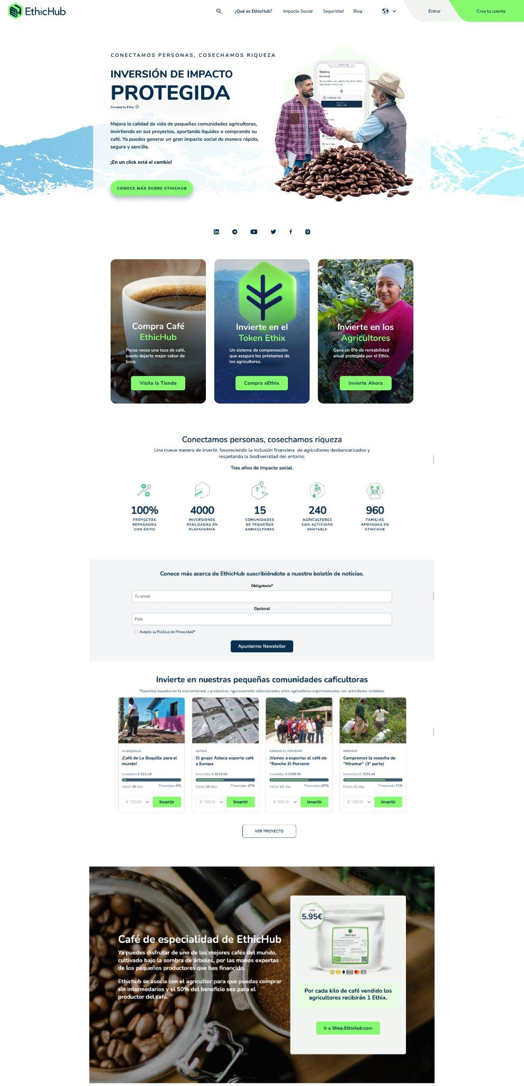
EthicHub Landing Page
ETHICHUB VISUAL GUIDE 2022

Slide 25

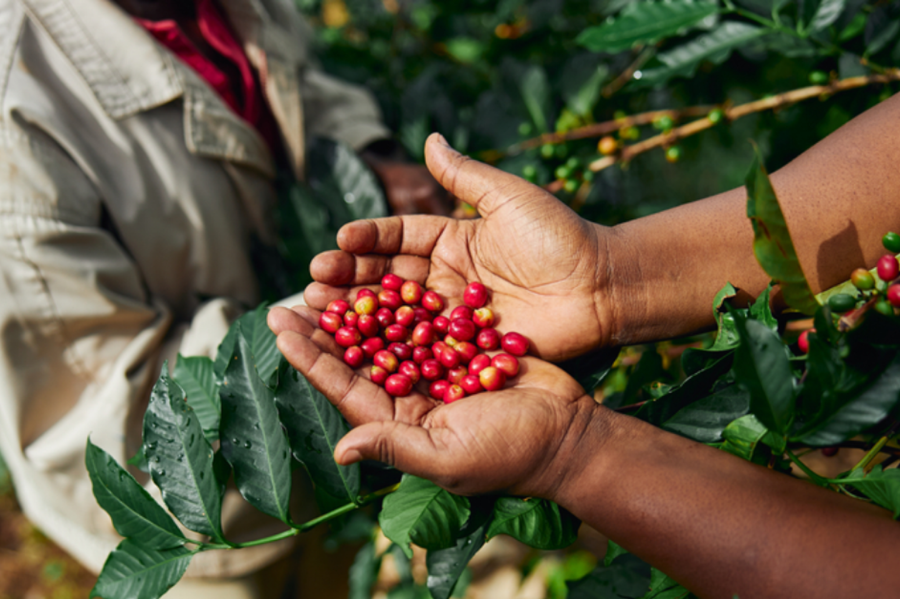
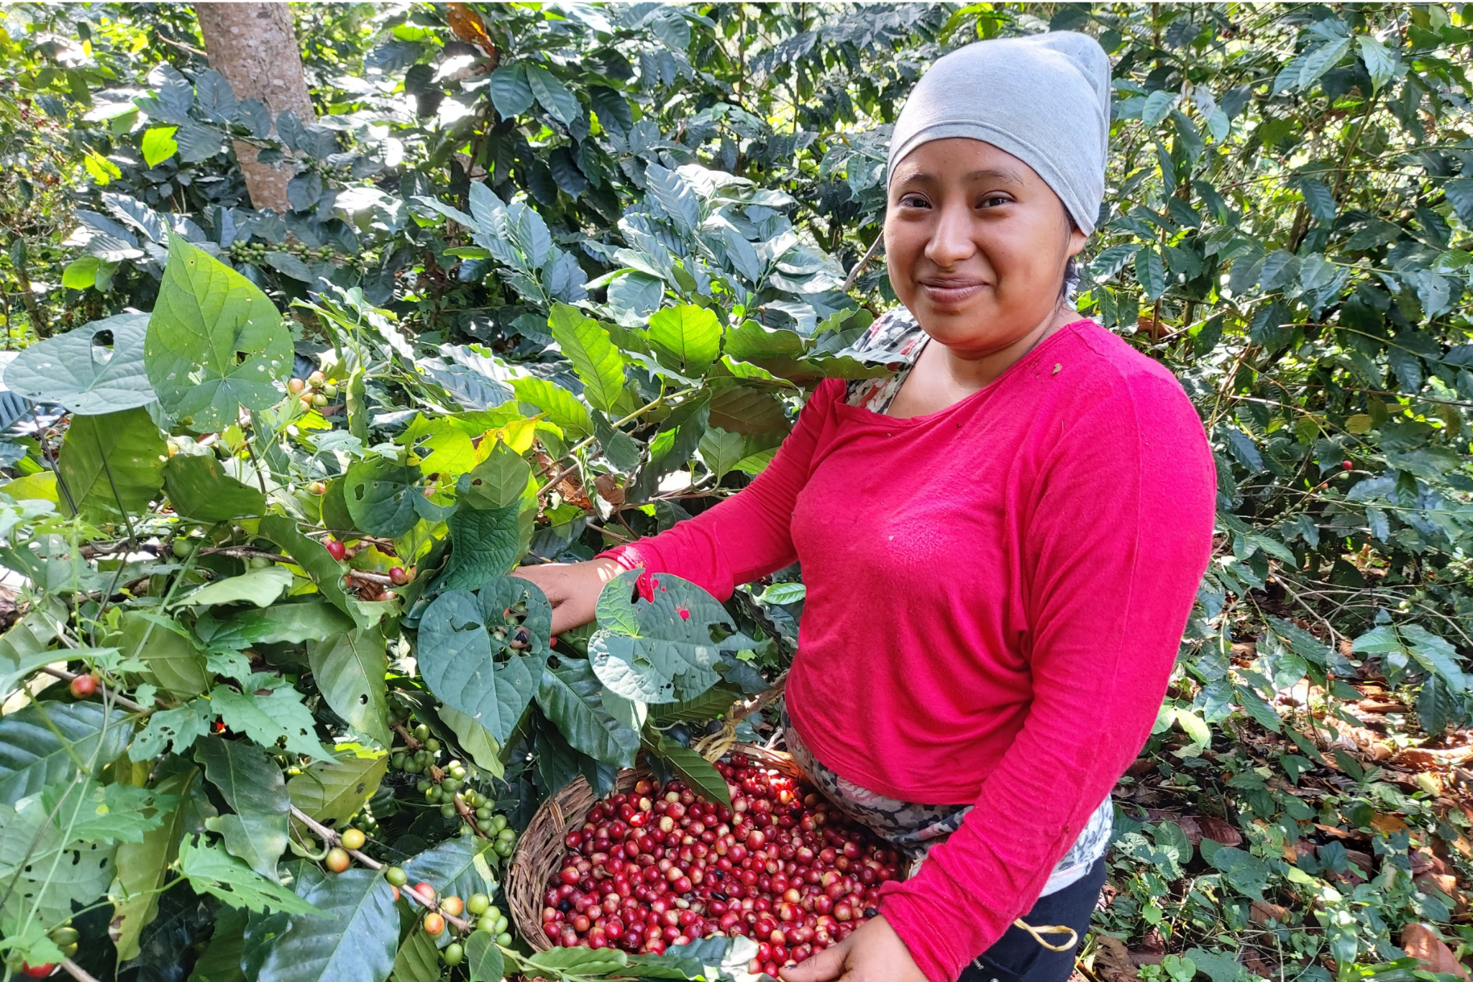
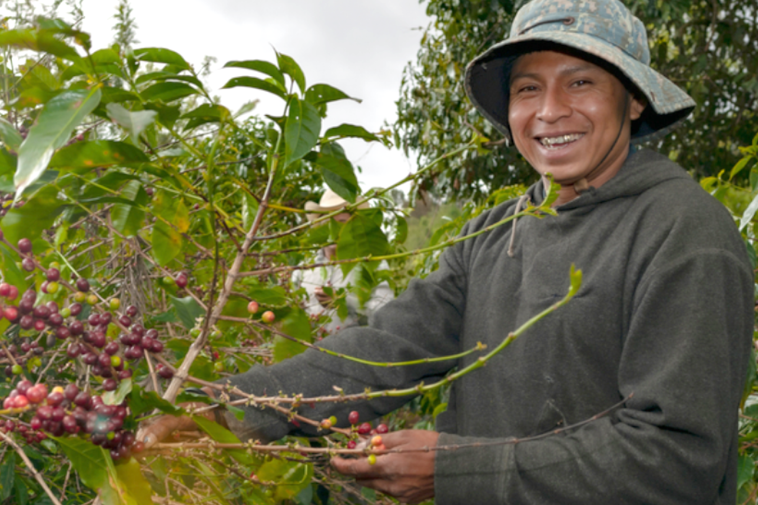
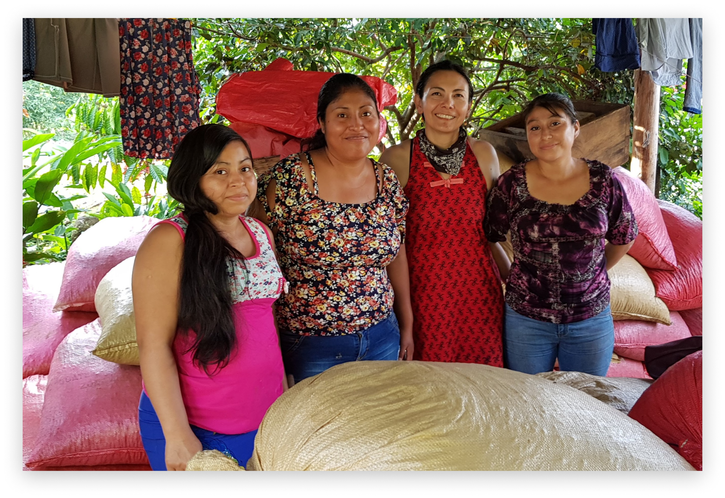

Photography
ETHICHUB VISUAL GUIDE 2022
Photos and stock images should represent the life of coffee farmers, the quality of their product, uses and the relation between lenders and communities through EthicHub.

Slide 26
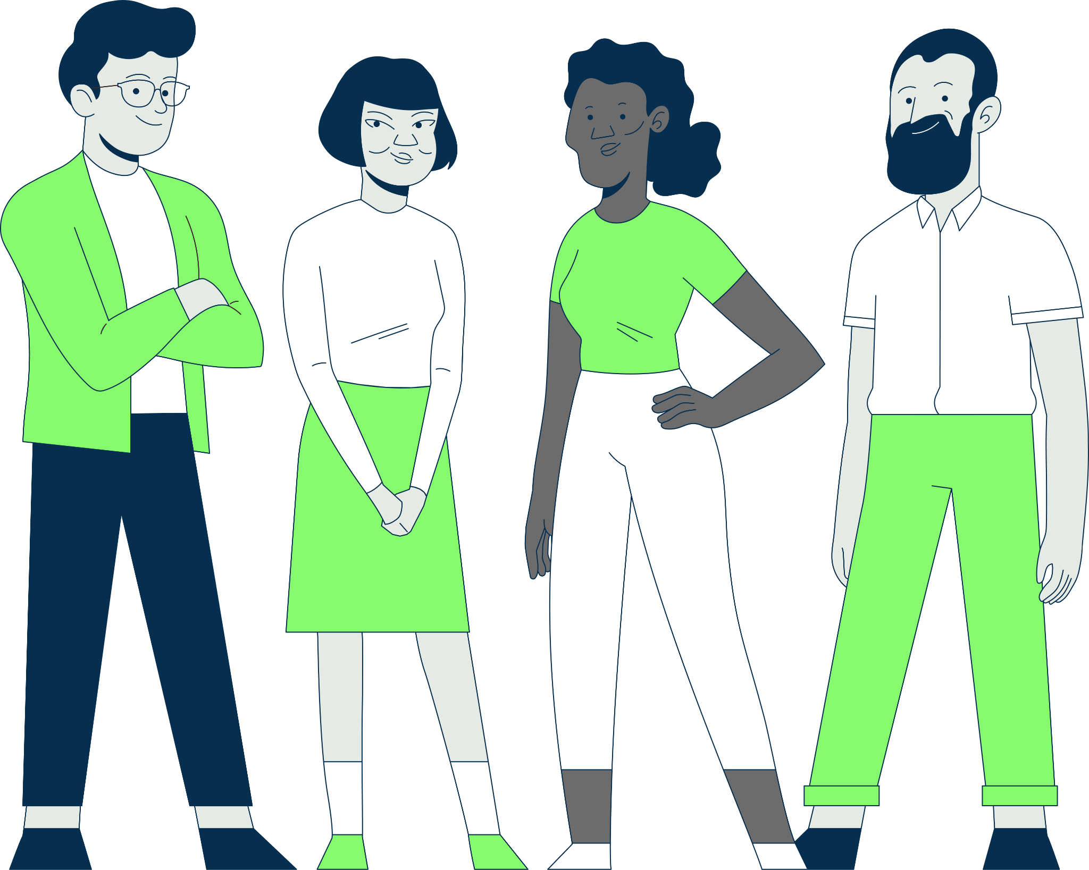

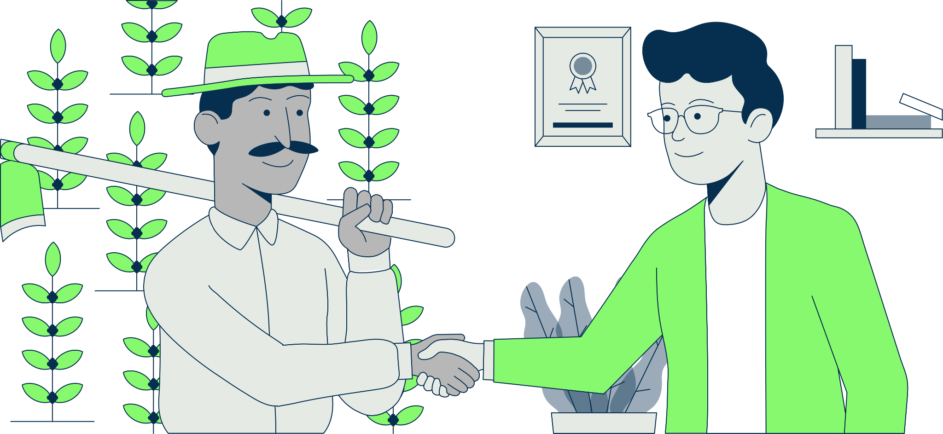
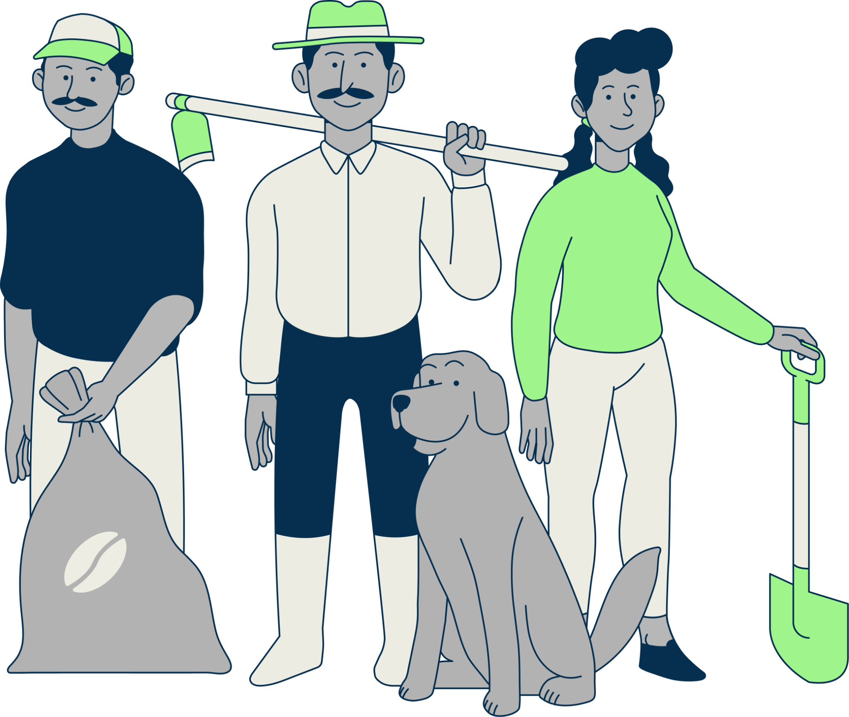
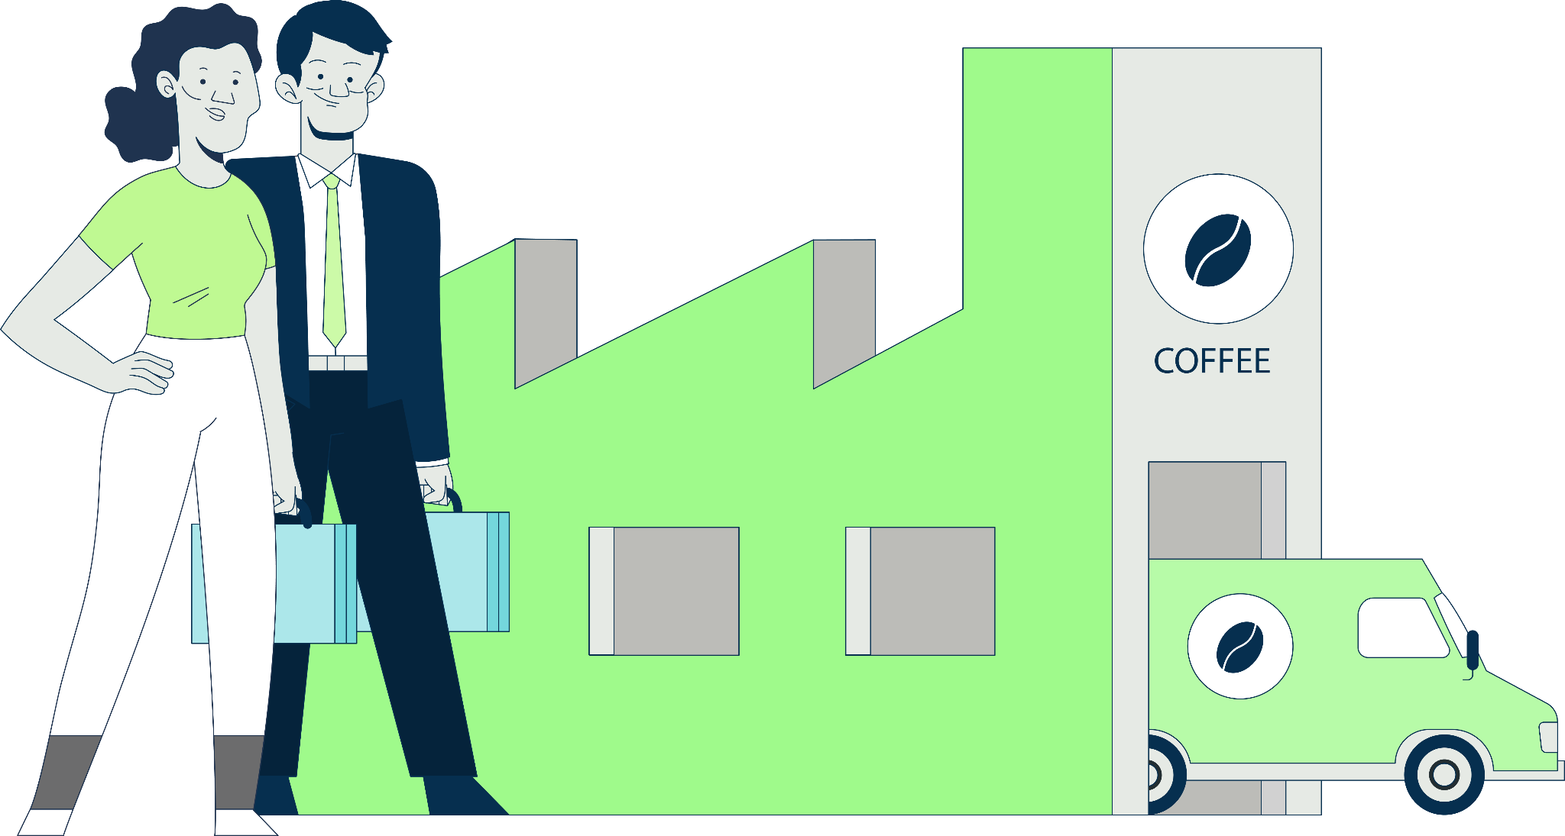
Illustrations
ETHICHUB VISUAL GUIDE 2022
Illustrations should represent the user, farmers, their diversity, lifestyle and technology. All this while maintaining the base colors and brand of EthicHub and it’s platform.

Slide 27








Iconography illustrations
ETHICHUB VISUAL GUIDE 2022
Iconography demonstrate goals and achievements for EthicHub and have a strong relation with illustration in general.
Download Icons

Slide 28
Glossary

Slide 29
Logos
ETHICHUB VISUAL GUIDE 2022
You can find material resources through the following links:
EthicHub Logo
EthicHub Vertical Logo
Cryptocafé Logo
JPEG Logo
JPEG RGB Logo
Cryptocafé Vertical Logo
PNG Logo
JPEG CMYK Logo
Cryptocafé Horizontal Logo
Editable Logo
PNG RGB Logo
SVG Logo
PNG CMYK Logo
JPEG CMYK (ESP) Logo
Editable Logo
JPEG CMYK (ENG) Logo
SVG Logo
JPEG RGB (ESP) Logo
JPEG RGB (ENG) Logo
Icon CMYK Logo
Icon RGB Logo

Slide 30
Fonts
ETHICHUB VISUAL GUIDE 2022
You can find material resources through the following links:
Nunito Font
Nunito Sans Font
Iconography
Download font
Download font
Download Icons

